Slide 1
Dynamic disabling/enabling of EMC based on traffic pattern
Anju Thomas
Nitin Katiyar
Vishal Deep Ajmera
Venkatesan Pradeep

Slide 2
AGENDA
Cache lookup path in OVS
EMC vs SMC - A closer look
Why dynamic ?
Solution
Summary

Slide 3
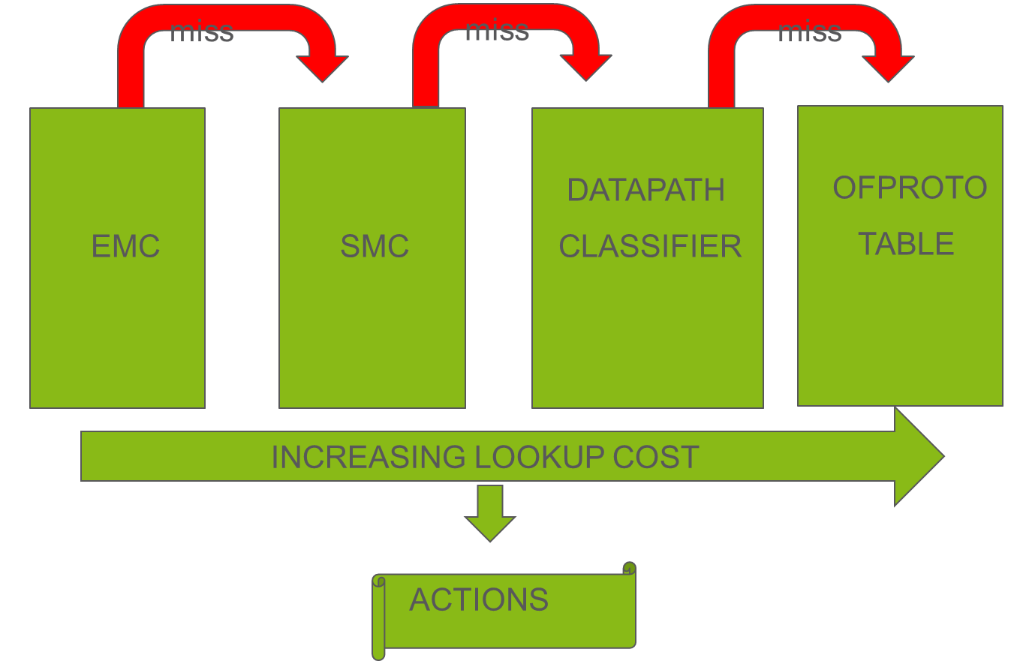
CACHE LOOKUP

Slide 4
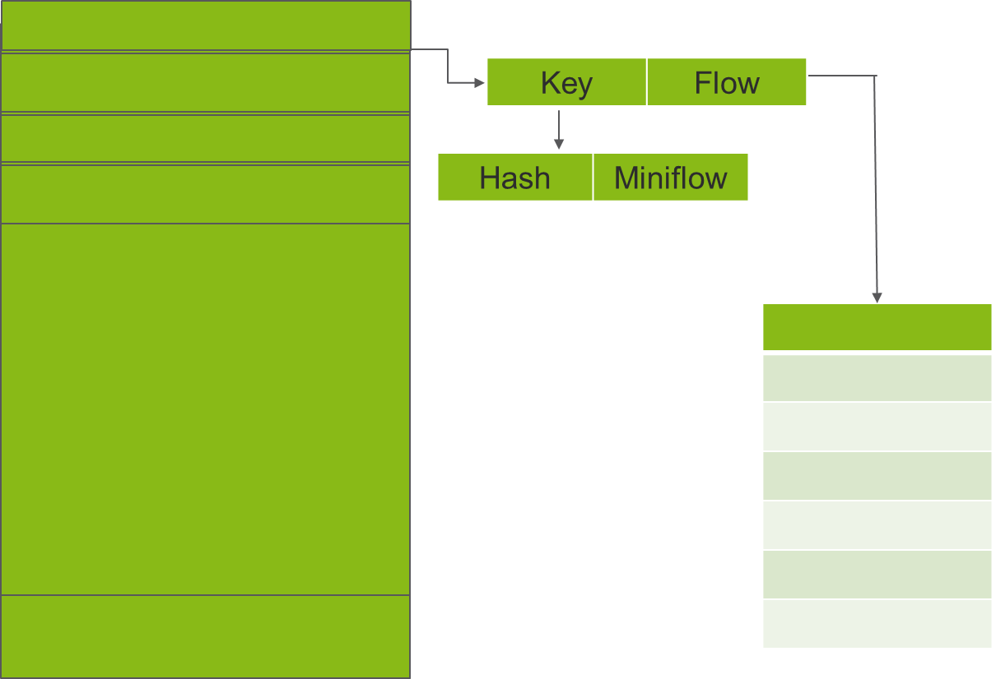
EMC LAYOUT
emc_cache
1 emc_entry
2
.
.
.
.
.
8192
pmd->flow_table

Slide 5
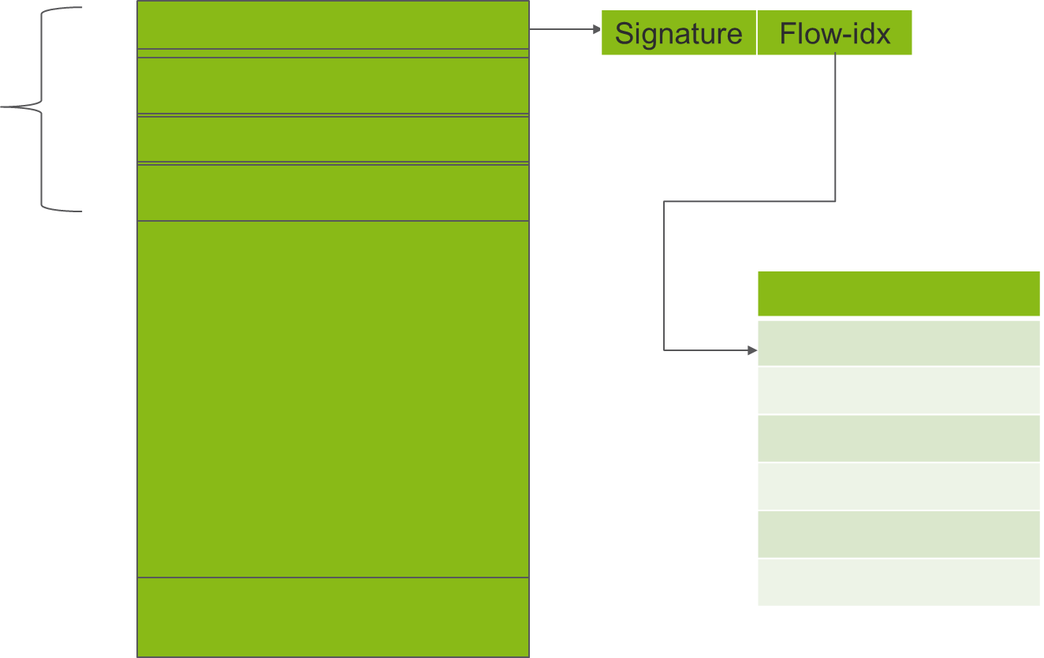
SMC LAYOUT
smc_cache
1
2
bucket1 3
4
1048576
pmd->flow_table

Slide 6
EMC vs SMC
Both use 5 tuple hash or RSS hash
EMC:
Each hash can index two entries (13 bits at a time)
Each entry stores hash, miniflow & pointer to flow in pmd flow table.
2^13 = 8192 EMC entries
Memory footprint
SMC:
Number of buckets = 1 << 18 = 262,144
4 entries per bucket
Each entry stores 16 bit signature & 16-bit index to flow in pmd flow table.

Slide 7
WHY DYNAMIC ?
Avoid EMC thrashing (causes performance degradation)
Need to adapt to varying traffic pattern
Utilize EMC & SMC efficiently
Observations on actual customer deployments

Slide 8
PROPOSED SOLUTION
Identify if system has frequent EMC thrashing.
Use this information to dynamically disable EMC thereby eliminating ‘cache thrashing’ scenario and improving packet switching performance
Once EMC has been disabled the OVS would periodically turn on the EMC insertion but will not perform EMC lookup for packets processing as part of dry run.
Post some soaking time, check if EMC is still consistently thrashed or not .
If system has recovered for multiple such iterations we enable EMC .
If system has still not recovered evaluate the system after some backoff period

Slide 9
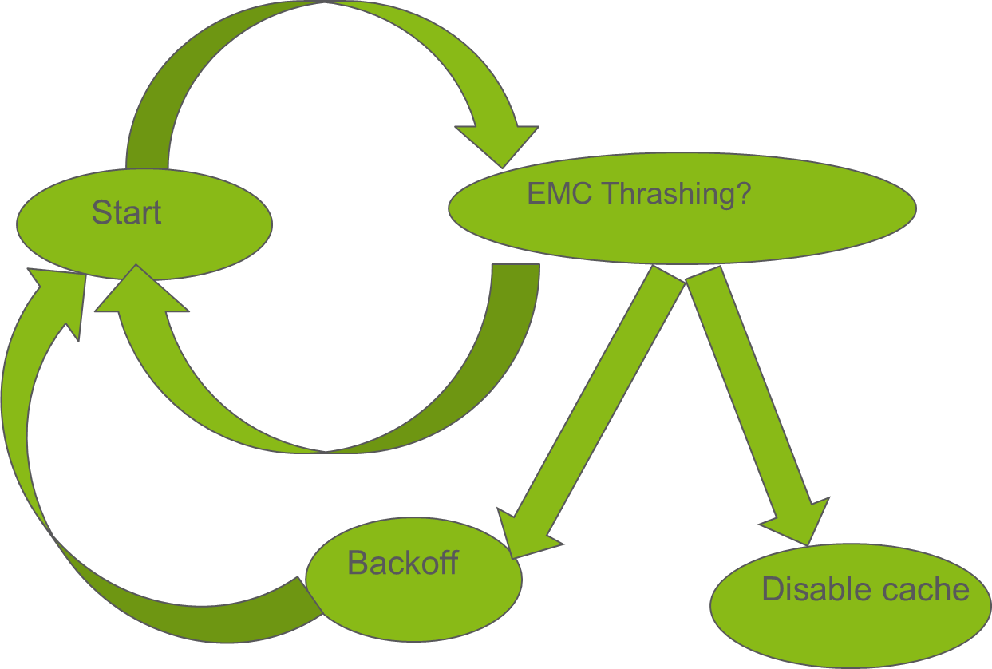
DISABLING EMC
Sampling time
Repeat N Iterations
N
Y

Slide 10
WHEN TO DISABLE EMC
Factors used to determine if EMC thrashing is happening:
Number of evictions
Number of insertions
Number of hits
Example:
(Number of evictions / (Number of insertions + Number of hits)) * 100 > disable threshold (in percentage)

Slide 11
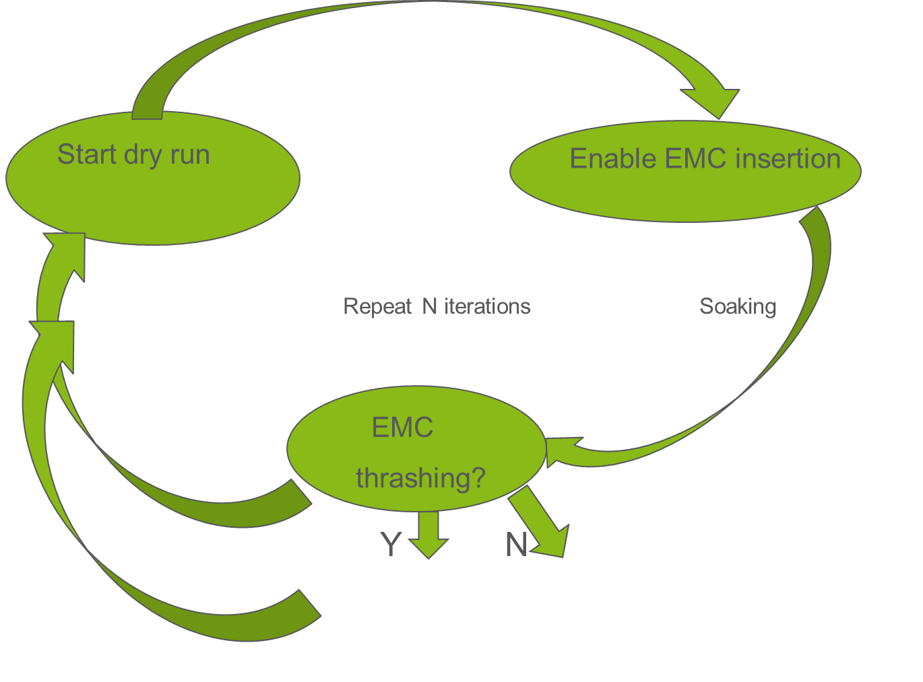
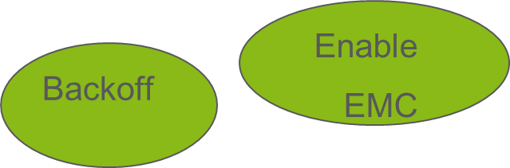
ENABLING EMC

Slide 12
WHEN TO RE-ENABLE EMC
How to know that system has recovered from EMC thrashing?
Number of evictions
Number of attempted insertions
Example :
(Number of evictions / Number of attempted insertions) *100 < enable_threshold

Slide 13
SUMMARY
Static cache configuration not suitable for customer deployments
Performance of EMC dependent on traffic pattern.
Certain traffic pattern can negate the advantages of having EMC
System should be able to learn and adapt to enable and disable EMC to give maximum performance

Slide 14
THANK YOU

